Slide 1
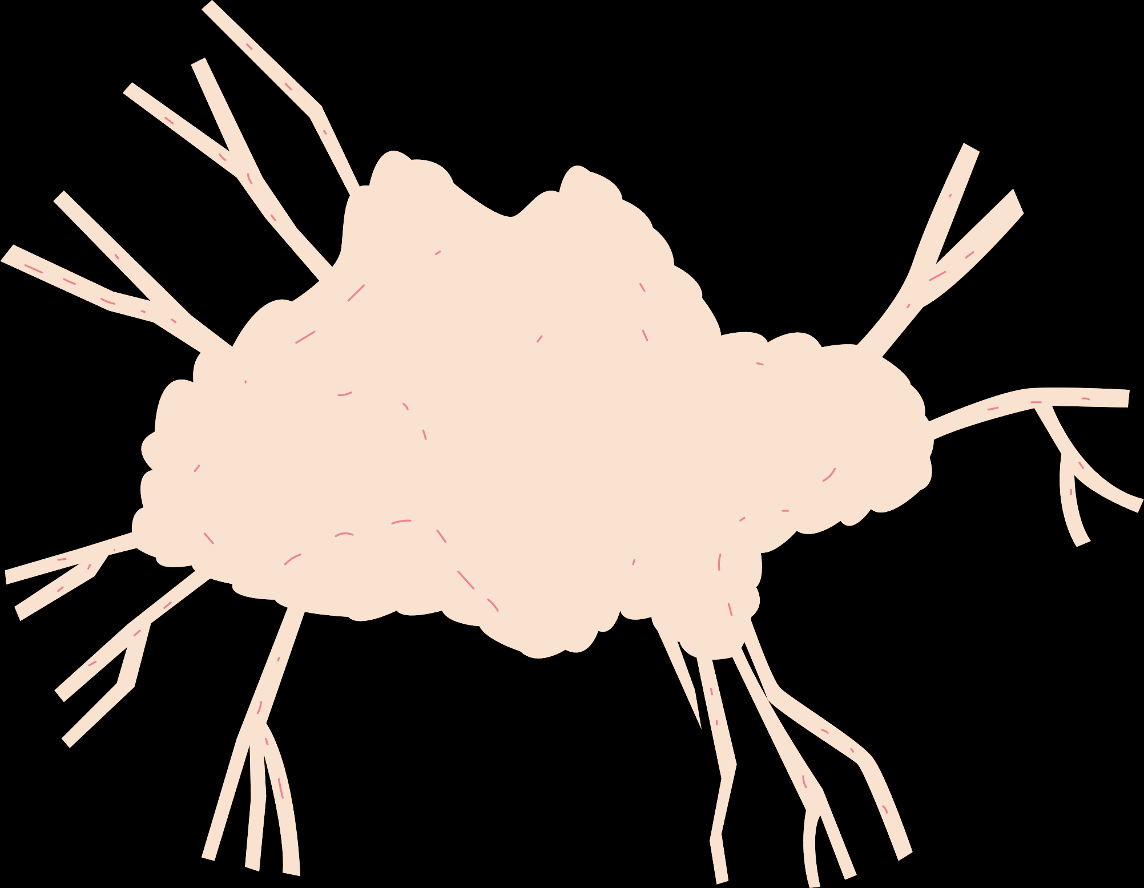
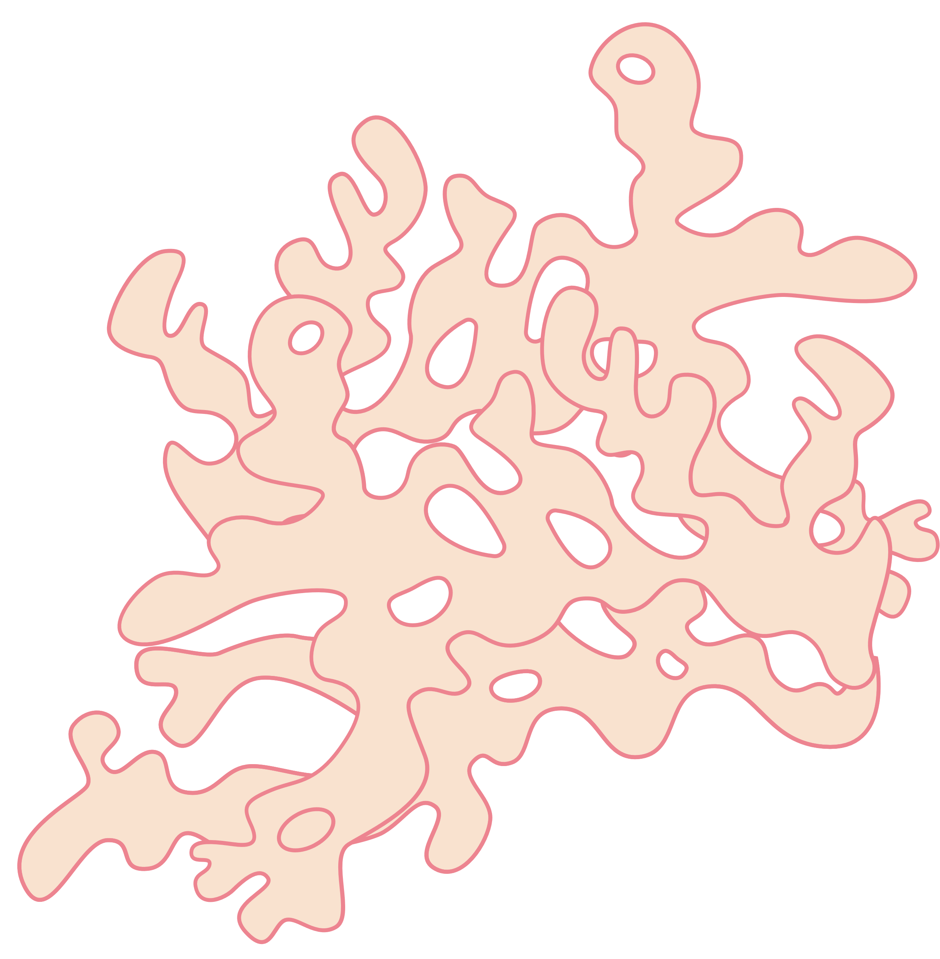





Donate Organs
Save Lives
ORGAN
BANK
Presented By :
DONA JINCE
MAC23MCA-2024
Project Guide:
Nisha Markose

Slide 2


INTRODUCTION
FUNCTIONALITIES
DONATE ORGANS
SAVE LIVES
OBJECTIVES
TECHNOLOGY
CONTENTS
ACTORS
RELEVANCE

Slide 3

Introduction
The Organ Bank is a web-based application designed to streamline the process of organ donation and transplantation.
This platform connects donors, recipients, and hospitals through a centralized database, facilitating efficient organ allocation and management.
Donors can register their willingness to donate organs by providing necessary medical details and preferences.
Recipients can register their requests for specific organs, along with medical records to verify compatibility.
Hospitals play a crucial role by managing organ availability, conducting compatibility tests, and updating transplant records.

Slide 4


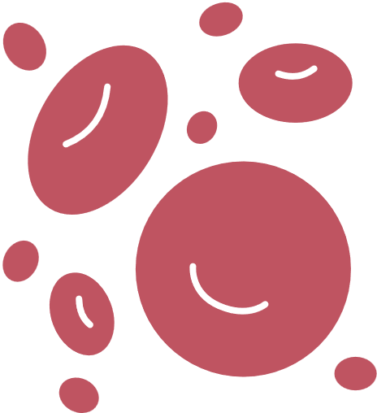
Objectives
Encourage Organ Donation:
Simplify registration to motivate individuals to donate organs and raise awareness about its importance.
Transparency:
Build trust through a transparent organ allocation process and real-time updates.
Centralized Management:
Provide a single platform to connect donors, recipients, and hospitals for effective organ donation and transplantation.
Automated Matching:
Use compatibility criteria (e.g., blood type, urgency, organ type) to ensure fair and efficient organ allocation.
Real-Time Notifications:
Notify donors, recipients, and hospitals promptly about matches and updates in the system.

Slide 5

ACTORS
01
02
03
04
ADMIN
DONORS
RECEIPIENTS
HOSPITALS
The admin oversees the entire system to ensure its smooth operation, ethical functioning, and data integrity.
Donors are individuals who wish to donate their organs, either during their lifetime or posthumously.
Recipients are patients who need organ transplants.
Hospitals are authorized medical institutions that perform organ transplantation surgeries.

Slide 6



FUNCTIONALITIES
User Management:Verify and approve registrations of donors, recipients, and hospitals.
Data Validation:Ensure that all medical records and personal information submitted by users are accurate and complete.
System Monitoring:Monitor organ allocation processes to maintain fairness and transparency.
Database Maintenance:Manage and update the central database, including adding or removing records as necessary.
ADMIN
Reports and Analytics:Generate reports on organ availability, transplantation statistics, and donor-recipient trends.
Resolve Issues:Address any disputes or technical issues arising during system use.

Slide 7
FUNCTIONALITIES
Registration:Provide personal details, medical history, and the organs they wish to donate.
Profile Management:Update their information, such as address or medical status, as needed.
DONORS
Consent:Confirm their willingness to donate specific organs at the time of registration.
Notification Handling:Receive notifications if their donation is eligible for a recipient match or for updates regarding their donation status.

Slide 8
FUNCTIONALITIES
Registration:Submit a request for specific organs, along with their medical details and eligibility documents.
Profile Management:Update their health records or change organ request preferences if necessary.
RECEIPIENTS
Monitoring:Track the status of their request and receive notifications when a matching organ becomes available.
Medical Coordination:
Collaborate with their selected hospital to proceed with the transplantation process upon organ allocation.

Slide 9
FUNCTIONALITIES
Registration:Provide hospital details, including location, contact information, and areas of specialization.
Request Management:Submit requests for organs on behalf of their patients, specifying the type and urgency.
HOSPITALS
Medical Verification:Verify the compatibility of a donated organ with a recipient before proceeding with transplantation.
Procedure Updates:Update the system after successful transplants, including recipient recovery status and organ usage.

Slide 10
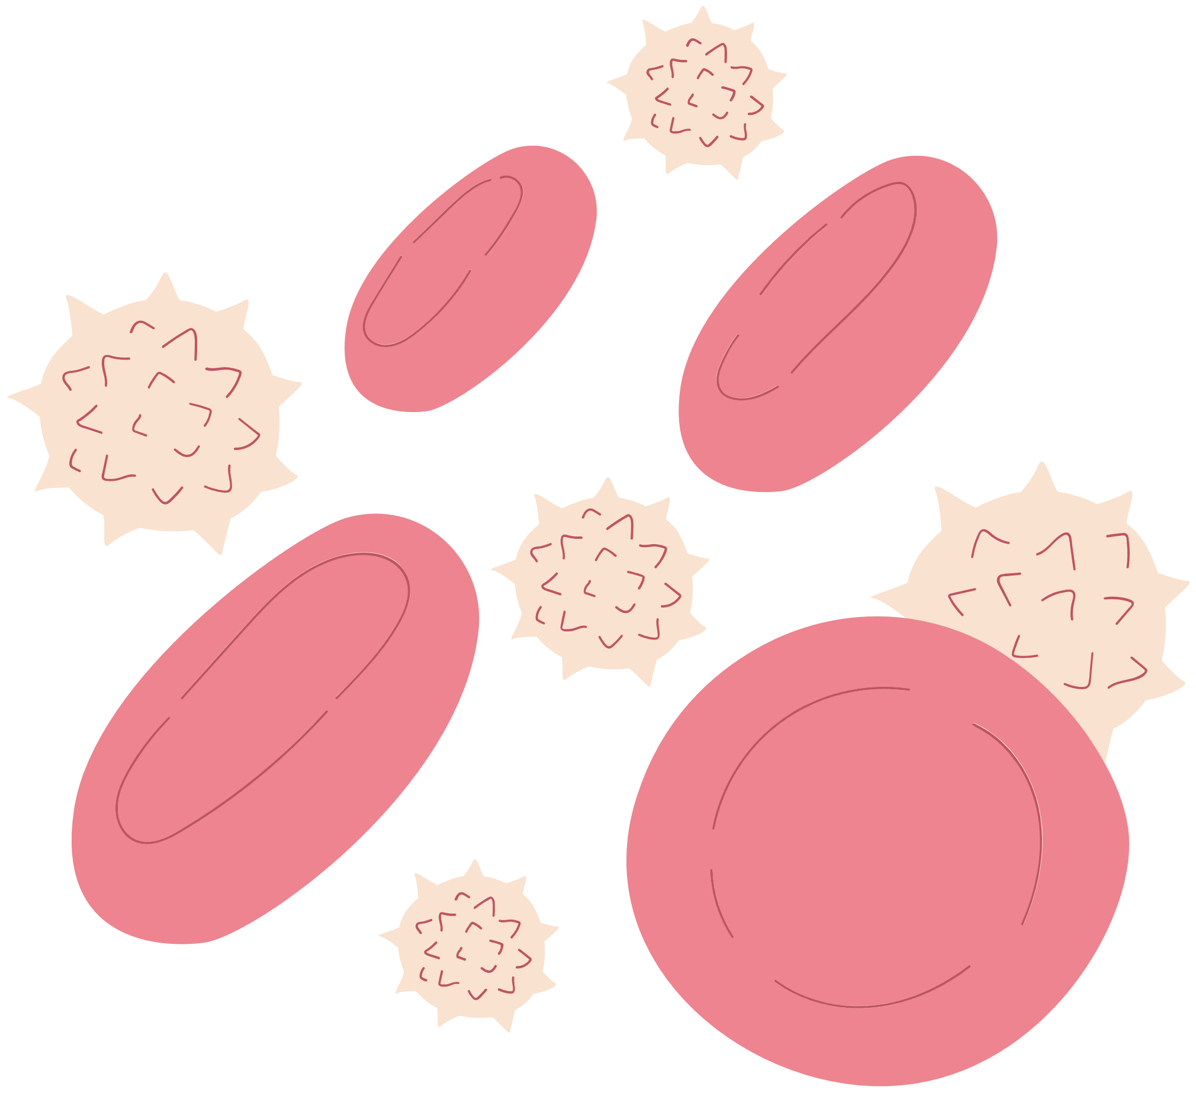
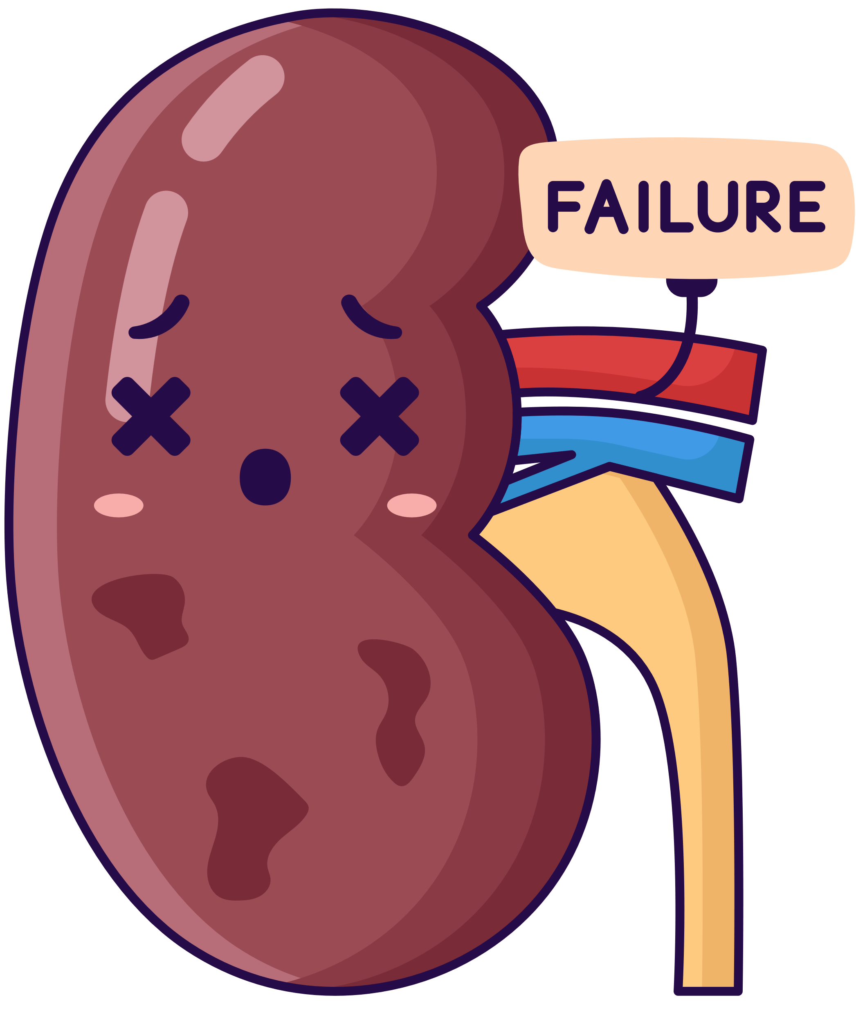
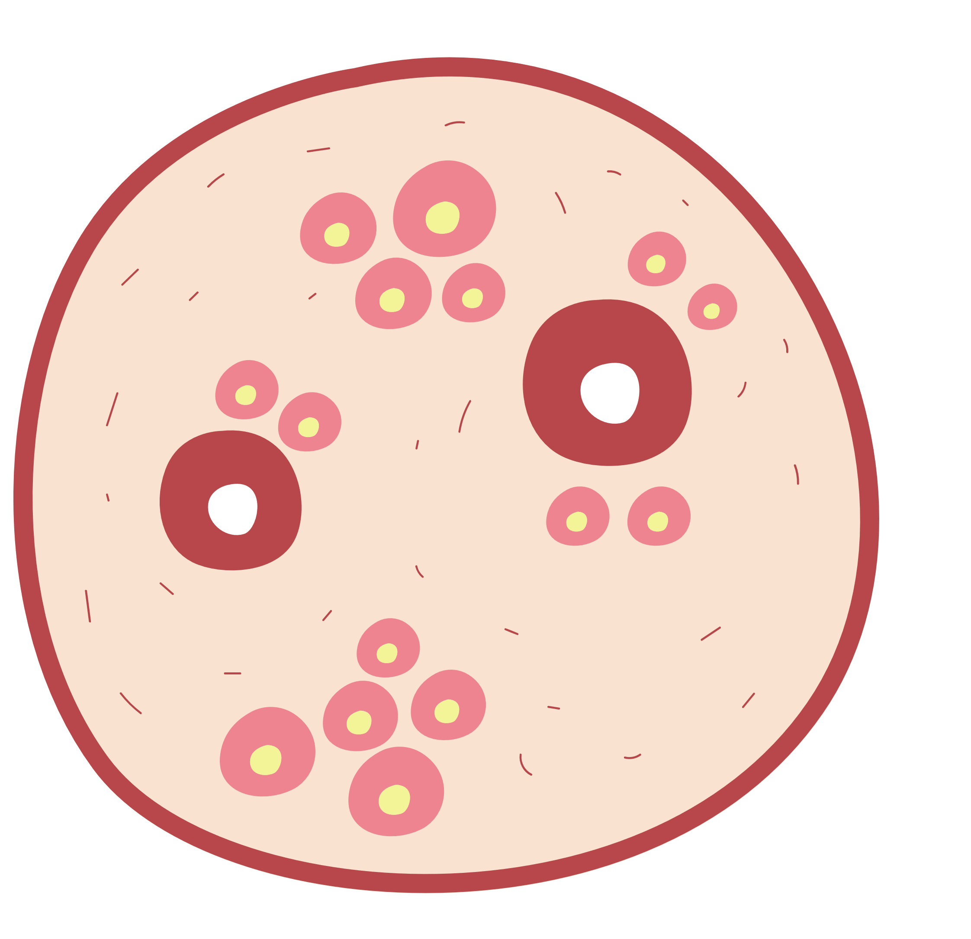
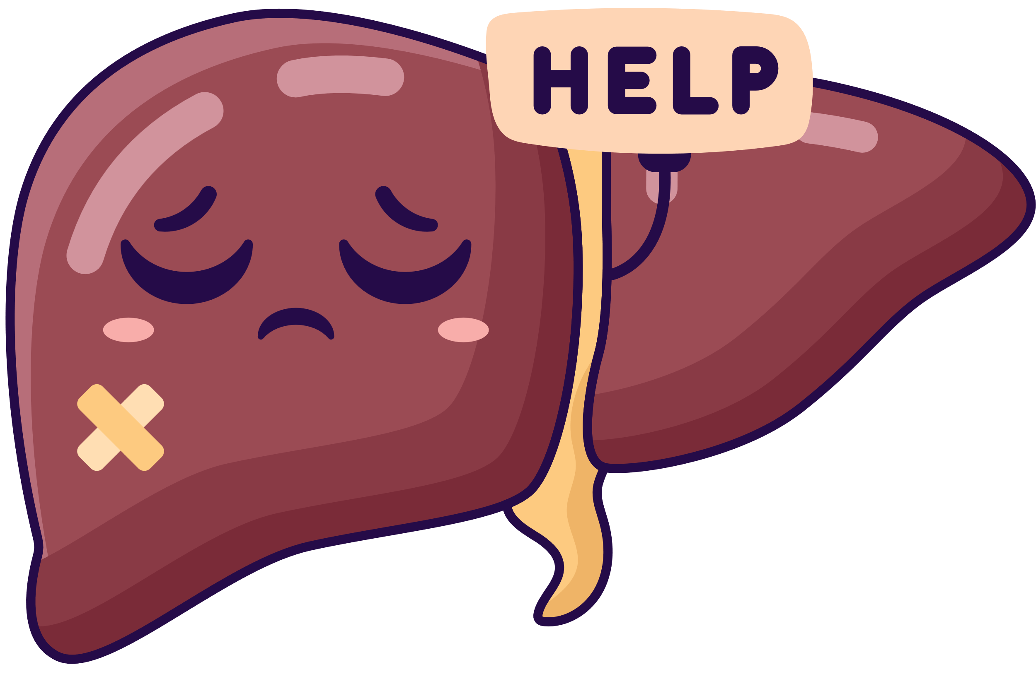

FRONTEND
BACKEND
HTML
CSS
JAVASCRIPT
PHP
TECHNOLOGY
DATABASE
ENVIRONMENT
MYSQL
XAMP

Slide 11


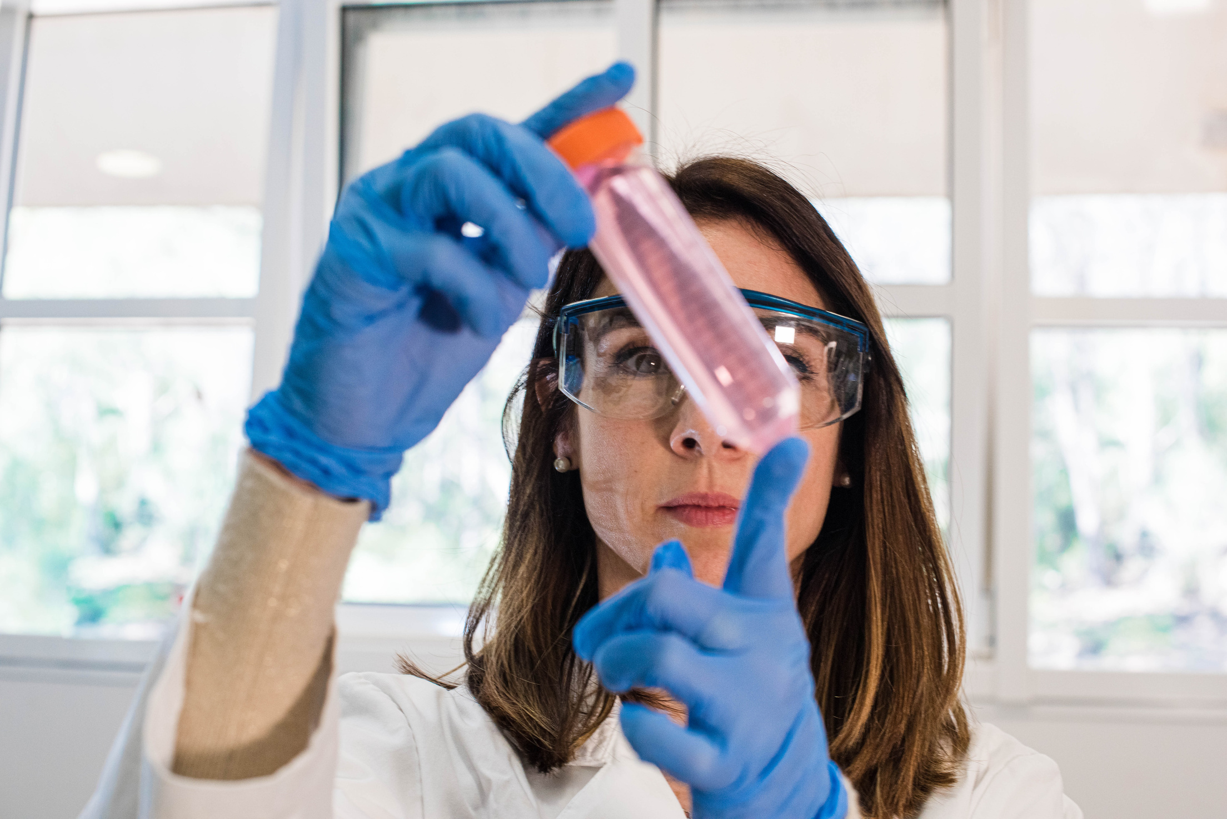
RELEVANCE
•Address the challenge of organ shortages and the inefficiencies in existing manual processes.
•By automating donor-recipient matching, providing real-time notifications, and maintaining secure medical records, the system reduces wait times and maximizes the utilization of available organs.
•it encourages more individuals to register as donors by ensuring transparency and building trust in the process.

Slide 12



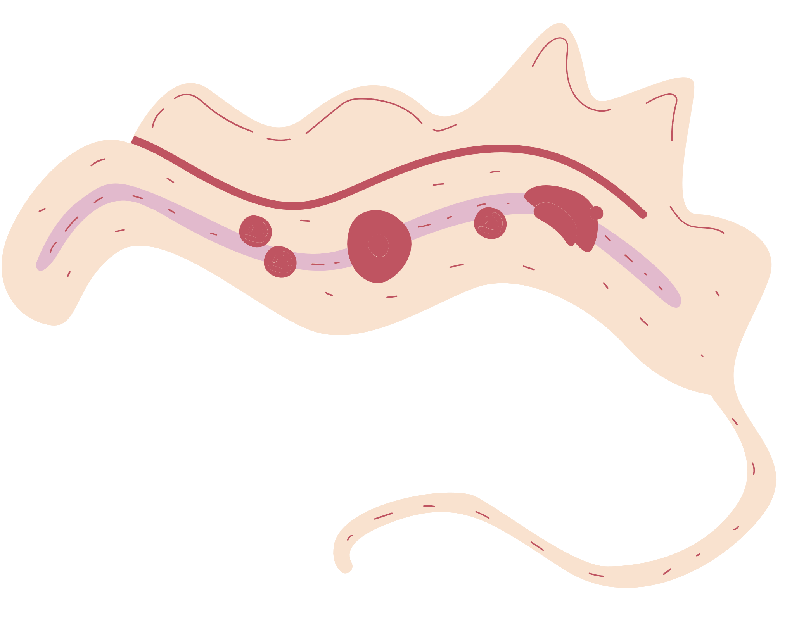
Thank you!

Slide 13

NODE JS

Slide 14
DATABASE INTEGRATION WITH NODE JS
1. Creating a Database Connection
2. Using DDL Commands in Node.js
Create a Table
Alter a Table
Drop a Table
Truncate a Table
3. Using DML Commands in Node.js
Insert Data
Update Data
Delete Data
Select Data
4. Executing the Commands
5.Example

